Slide 1
DATA ANALYTICS PROJECT US ACCIDENTS’ SEVERITY PREDICTION
TEAM NAME : 63_PESU_DA_0293_0314_1432 US Accident Severity Prediction
Team Members : Samarth G Vasist - PES1201801432
Vishesh P - PES1201800314
Sreejesh Saya - PES1201800293

Slide 2

About the Dataset
The dataset consists of 3.5 million records
Has 49 attributes describing each accident that has occurred in any of the 50 states of the United States
Analysis confined to 5 states of our choice namely California, Massachusetts ,Kentucky , Maryland and Louisiana which account up to 1 million records approximately
Target attribute for our analysis is Severity

Slide 3

Problem Statement
Severity is the target variable which is ordinal in nature and ranges from 1 to 4
Given the details of an accident, the severity of the accident will be predicted
Multi-class classification on the target variable
Classification algorithms such as Logistic regression, K nearest neighbours, Decision Trees, Naïve Bayes and Random Forest have been used and their results will be compared to obtain the best results.

Slide 4



Why is it important?
Road safety has become important now more than ever with increasing traffic throughout the world
Unfortunately, it has been neglected worldwide, leading to unfortunate traffic accidents
Current data of accidents need to be collected and analysed to determine the conditions under accidents of varying severity occur
Given an instance consisting of various attributes(conditions), the chances of an accident occuring and its severity needs to be known accurately

Slide 5




Exploratory Analysis
Exploratory analysis was performed to determine the conditions under which accidents occur in each of the five states individually
Conditions include, but not limited to Weather, Time of occurrence and most common locations

Slide 6
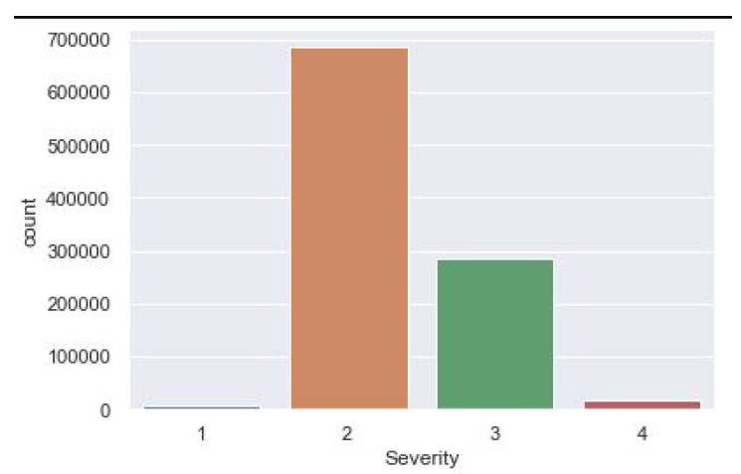
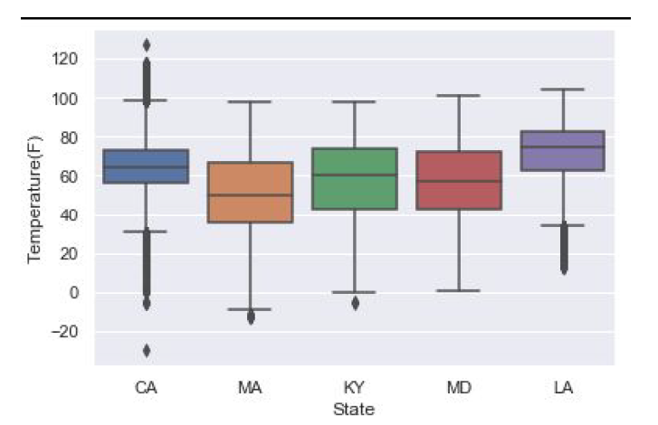
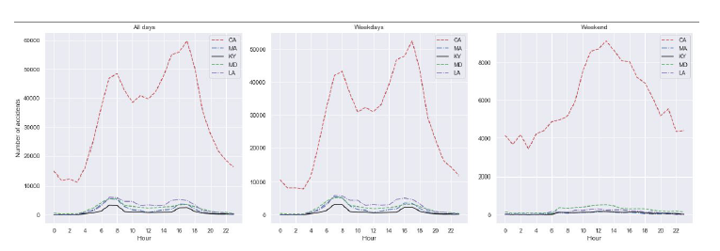
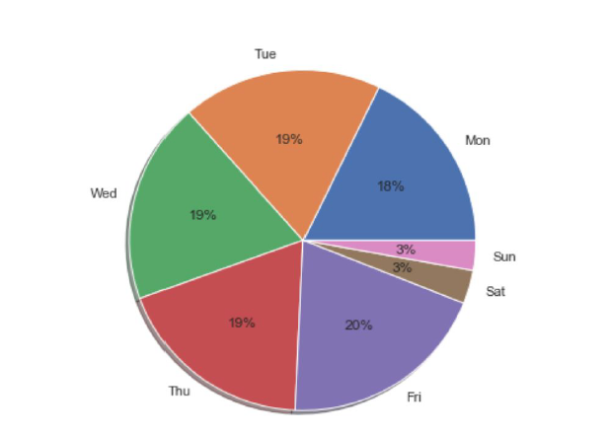
Exploratory Analysis - Graphs
Distribution of severity
Boxplot showing the distribution of temperature at the time the
accidents were recorded for each state
Time-series analysis resampled by Hour for all five states
Percentage of accidents occurring on each day of the week in the five states

Slide 7
Data Preprocessing - 1
Missing values need to be filled appropriately and unwanted columns need to be dropped
Data preprocessing performed on the records of each state separately and not as a whole to produce better results
Columns having more than 50% missing values out of the total number of records were dropped
Columns with repetitive data or those that contributed nothing to the predictions were dropped

Slide 8
Data Preprocessing - 2
Boxplots were plotted for the numerical attributes to determine the number of outliers
If the number of outliers wasn’t a lot, the missing values were filled with the median of the attribute
If there were too many outliers, flooring and capping was done on the attributes followed by filling the missing values with the medians

Slide 9


Data Preprocessing - 3
All the missing values in the categorical attributes were filled with the mode of their attributes’ categories respectively
Correlation plots and a heatmap signifying the correlation between each pair of numerical attributes were plotted
All numerical attributes were Standardized while all categorical attributes were either Label encoded or One-Hot encoded as required

Slide 10
Our Approach
The dataset was first split into Training and Testing sets for each state
Various classification methods were used such as Logistic Regression, K – Nearest Neighbours, Decision Trees, Random Forest and Naïve Bayes
A comparative study was performed between the results of all the models built to determine the most suitable classifier
To perform the comparative analysis, we made use of the testing set accuracy obtained from any and every model built, trained on the training data and tested on the testing set

Slide 11
Logistic Regression
Multi-class logistic regression was implemented for predicting the severity of accidents
We also implemented dimensionality reduction using Principal Component Analysis (PCA) where we chose 2 components
However after thorough testing it was later concluded that PCA is not suitable for our analysis as did not perform well on our dataset
Logistic Regression works better without combining PCA with it

Slide 12
K – Nearest Neighbours
We used the Elbow method to determine the best value of K(number of neighbours)
The best value of K was used to perform multi – class classification

Slide 13
Decision Trees
To get the best models and results, the parameters such as max_depth and criterion were changed accordingly
The criterion was set to Entropy and Gini Index and tested several times

Slide 14
Random Forest
After numerous tests, we decided to maintain 10 trees for our models
The criterion was set to Entropy
Gave us excellent results

Slide 15
Naïve Bayes
Gaussian Naïve Bayes specifically was used to classify accident severity
The results proved to be unsatisfactory as the accuracy never crossed 70% under any circumstance

Slide 16



Results and Conclusions
After numerous tests and comparisons, it was found that Random Forest is the best classifier to classify traffic accidents’ severity in the US provided the details of the accidents
One could recreate any set of conditions and feed to the Random Forest model and it would predict the severity of the accident(if it occurred) accurately
It would greatly help understand the dangers of accidents and take preventive measures for the future
Although our analysis has been restricted to the US, the prediction of severity itself can be applied worldwide provided updated traffic accident data

Slide 17
Contribution of each member
Sreejesh Saya – PES1201800293 : Exploratory Analysis and testing of models
Vishesh P – PES1201800314 : Exploratory Analysis, Preprocessing and model building
Samarth G Vasist – PES1201801432 : Exploratory Analysis, Preprocessing and model building
All of us contributed equally to the writing of the reports, cleaning up of code and making the video presentation.

Slide 18

THANK YOU

